Slide 1
Database Design, Architecture and Model

Slide 2
Database Design
Database Design is a collection of processes that facilitate the designing, development, implementation and maintenance of enterprise data management systems.
Properly designed database are easy to maintain, improves data consistency and are cost effective in terms of disk storage space. The database designer decides how the data elements correlate and what data must be stored.
The main objectives of database designing are to produce logical and physical designs models of the proposed database system.

Slide 3
Database Design (Cont..)
The logical model concentrates on the data requirements and the data to be stored independent of physical considerations. It does not concern itself with how the data will be stored or where it will be stored physically.
The physical data design model involves translating the logical design of the database onto physical media using hardware resources and software systems such as database management systems (DBMS).

Slide 4
Why Database Design is Important ?
It helps produce database systems
That meet the requirements of the users
Have high performance.
It helps to understand work mechanism and workflow of database which will be very helpful during upgradation, migration or troubleshooting.
Database designing is crucial to high performance database system.
Note , the genius of a database is in its design . Data operations using SQL is relatively simple.

Slide 5
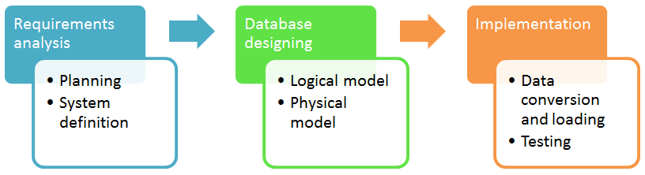
Database development life cycle

Slide 6
Requirement Analysis
Planning - This stages concerns with planning of entire Database Development Life Cycle. It takes into consideration the Information Systems strategy of the organization.
System definition - This stage defines the scope and boundaries of the proposed database system.

Slide 7
Database designing
Logical model - This stage is concerned with developing a database model based on requirements. The entire design is on paper without any physical implementations or specific DBMS considerations.
Physical model - This stage implements the logical model of the database taking into account the DBMS and physical implementation factors.

Slide 8
Implementation
Data conversion and loading - this stage is concerned with importing and converting data from the old system into the new database.
Testing - this stage is concerned with the identification of errors in the newly implemented system .It checks the database against requirement specifications.

Slide 9
View of Data
A database system is a collection of interrelated data and a set of programs that allow users to access and modify these data.
A major purpose of a database system is to provide users with an abstract view of the data. That is, the system hides certain details of how the data are stored and maintained.
Data models
A collection of conceptual tools for describing data, data relationships, data semantics, and consistency constraints.
Data abstraction
Hide the complexity of data structures to represent data in the database from users through several levels of data abstraction
Notes:
Abstract- existing in thought or as an idea but not having a physical or concrete existence; existing in thought or as an idea but not having a physical or concrete existence.
Constraints are the rules enforced on the data columns of a table. These are used to limit the type of data that can go into a table. E.g: Primary key, Foreign Key, Index, Not Null

Slide 10
Data Models
Data models define how the logical structure of a database is modeled. Data Models are fundamental entities to introduce abstraction in a DBMS. Data models define how data is connected to each other and how they are processed and stored inside the system.
The very first data model could be flat data-models, where all the data used are to be kept in the same plane. Earlier data models were not so scientific, hence they were prone to introduce lots of duplication and update anomalies.
A collection of tools for describing
Data
Data relationships
Data semantics
Data consistency constraints
A data model provides a way to describe the design of a database at the physical, logical and view level.
Notes:
Constraints are the rules enforced on the data columns of a table. These are used to limit the type of data that can go into a table. E.g: Primary key, Foreign Key, Index, Not Null

Slide 11
Data Models (Cont..)
The data model can be classified in four different categories:
The Entity-Relationship Model
Relational Model
Object-Based Data Model
Semi-structured Data Model
Other Old models:
Network Model
Hierarchical Model

Slide 12
The Entity-Relationship Model
Entity-Relationship (ER) Model is based on the notion of real-world entities and relationships among them. While formulating real-world scenario into the database model, the ER Model creates entity set, relationship set, general attributes and constraints.
The entity-relationship (E-R) data model uses a collection of basic objects, called entities, and relationships among these objects.
The entity-relationship model is widely used in database design.
Notes:
Real world entities,
Relationship among them
ER models Creates Entity
Relationship set
General attributes
Constraints

Slide 13
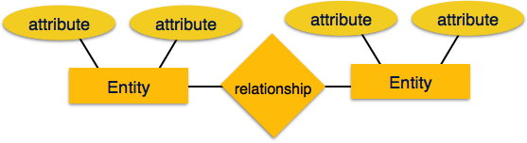
The Entity-Relationship Model (Cont..)
ER Model is based on −
Entities and their attributes.
Relationships among entities.
Notes:
Real world entities,
Relationship among them
ER models Creates Entity
Relationship set
General attributes
Constraints

Slide 14
The Entity-Relationship Model (Cont..)
Entity
An entity is a “thing” or “object” in the real world that is distinguishable from other objects.
An entity in an ER Model has properties called attributes. Every attribute is defined by its set of values called domain. For example, in a school database, a student is considered as an entity. Student has various attributes like name, age, class, etc.
Relationship
The logical association among entities is called relationship. Relationships are mapped with entities in various ways. Mapping cardinalities define the number of association between two entities.

Slide 15
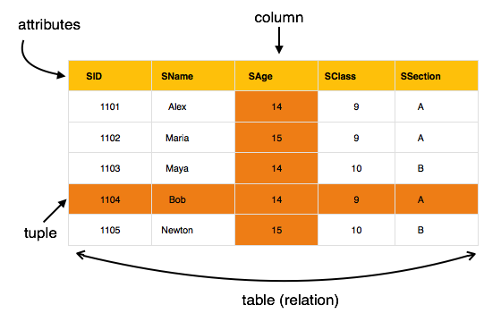
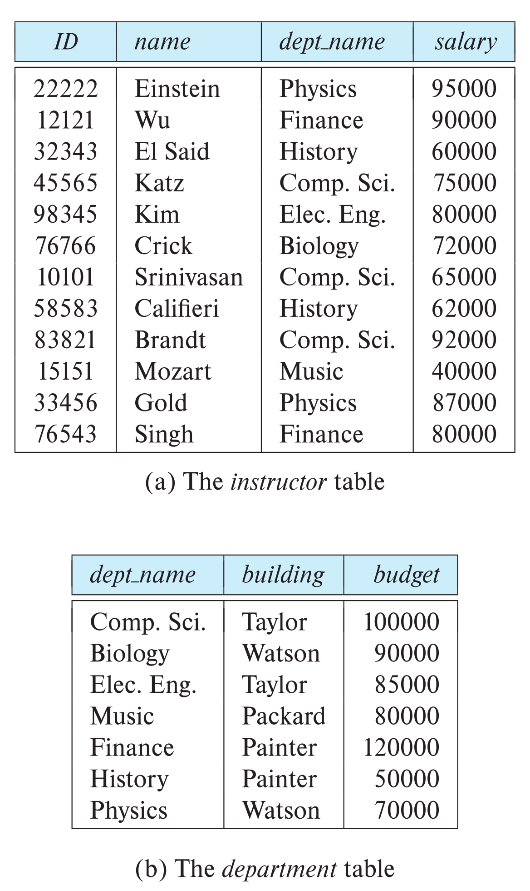
Relational Model
The most popular data model in DBMS is the Relational Model. It is more scientific model than others. All the data is stored in various tables.
Columns
Rows

Slide 16
Relational Model (Cont..)
The relational model uses a collection of tables to represent both data and the relationships among those data.
Each table has multiple columns, and each column has a unique name.
Tables are also known as relations.
The relational model is an example of a record-based model. Record-based models are so named because the database is structured in fixed-format of records of several types.
Each table contains records of a particular type. Each record type defines a fixed number of fields, or attributes. The columns of the table correspond to the attributes of the record type.
The relational data model is the most widely used data model, and a vast majority of current database systems are based on the relational model.

Slide 17
A Sample of Relational Database (Cont..)

Slide 18
Object-Based Data Model
Object-oriented programming (especially in Java, C++ or C#) has become the dominant software-development methodology.
This lead initially to the development of a distinct object-oriented data model, but today the concept of objects is well integrated into relational databases. Standards exist to store objects in relational tables.
Database systems allow procedures to be stored in the database system and executed by the database system. This can be seen as extending the relational model with notions of encapsulation, methods, and object identity.
Notes:
Dominant - having power and influence over others.

Slide 19
Semi-Structured Data Model
The semi-structured data model permits the specification of data where individual data items of the same type may have different sets of attributes.
This is in contrast to the data models mentioned earlier, where every data item of a particular type must have the same set of attributes.
JSON and Extensible Markup Language (XML) are widely used semi-structured data representations.

Slide 20
Data Abstraction
For the system to be usable, it must retrieve data efficiently. The need for efficiency has lead database system developers to use complex data structures to represent data in the database. Since many database-system users are not computer trained, developers hide the complexity from users through several levels of data abstraction, to simplify users’ interactions with the system:
Physical level: The lowest level of abstraction describes how the data are actually stored. The physical level describes complex low-level data structures in detail.
Notes:
Hide the complexity of data structures to represent data in the database from users through several levels of data abstraction
Data retrieval – efficiently
Data structure - complex

Slide 21
Data Abstraction (Cont..)
An architecture for a database system
Notes:
Physical level: lowest level of abstraction. How the data are actually stored. The physical level describes complex low-level data structures in detail.
Logical level: How data is store in database. Relation between data. Database administrator works here.

Slide 22
Data Abstraction (Cont..)
Logical level: The next-higher level of abstraction describes what data are stored in the database, and what relationships exist among those data. The logical level thus describes the entire database in terms of a small number of relatively simple structures. Although implementation of the simple structures at the logical level may involve complex physical-level structures, the user of the logical level does not need to be aware of this complexity. This is referred to as physical data independence. Database administrators, who must decide what information to keep in the database, use the logical level of abstraction.

Slide 23
Data Abstraction (Cont..)
View level. The highest level of abstraction describes only part of the entire database. Even though the logical level uses simpler structures, complexity remains because of the variety of information stored in a large database. Many users of the database system do not need all this information. Instead, they need to access only a part of the database. The view level of abstraction exists to simplify their interaction with the system. The system may provide many views for the same database.

Slide 24
Level Of Abstraction
Physical level: describes how a record (e.g., instructor) is stored.
Logical level: describes data stored in database, and the relationships among the data.
type instructor = record
ID : string; name : string; dept_name : string; salary : integer;
end;
View level: application programs hide details of data types. Views can also hide information (such as an employee’s salary) for security purposes.

Slide 25
Database Schema
A database schema is the skeleton structure that represents the logical view of the entire database. It defines how the data is organized and how the relations among them are associated. It formulates all the constraints that are to be applied on the data.
A database schema defines its entities and the relationship among them. It contains a descriptive detail of the database, which can be depicted by means of schema diagrams. It’s the database designers who design the schema to help programmers understand the database and make it useful.
Notes:
Skeleton structure
Represent Logical view
Relation among data - How data is associated with each other
Defines Entities
Relation among them
Presented by schema Diagram
Database designer design for programmer.

Slide 26
Database Schema (Cont..)
A database schema can be divided broadly into two categories −
Physical Schema − It is the overall physical structure of the database. This schema represents the actual storage of data and its form of storage like files, indices, etc. It also defines how the data will be stored in a secondary storage.
Logical Schema − It is the overall logical structure of the database. This schema defines all the logical constraints that need to be applied on the data stored. It defines tables, views, and integrity constraints.
Example: The database consists of information about a set of customers and accounts in a bank and the relationship between them.

Slide 27
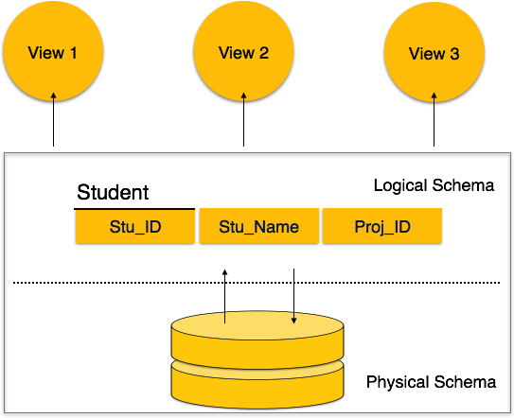
Database Schema (Cont..)

Slide 28
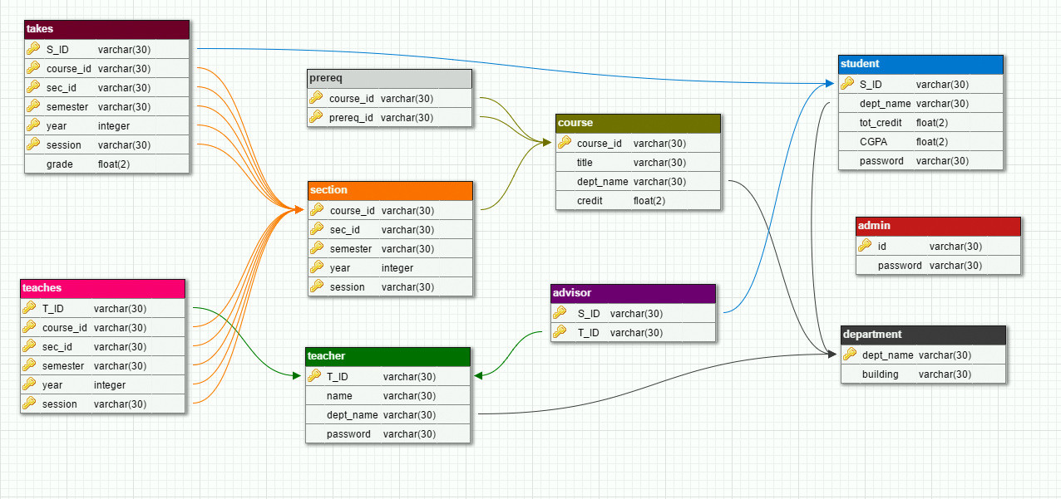
Database Schema – Logical (Cont..)

Slide 29
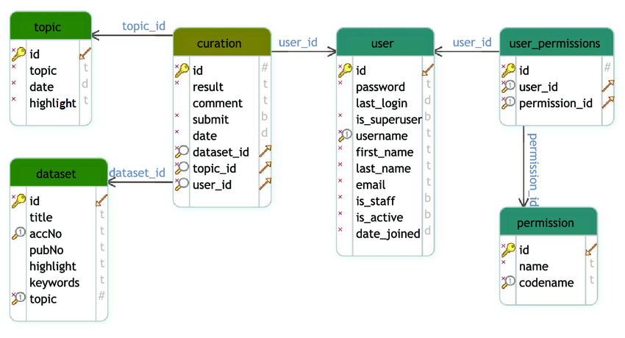
Database Schema – Logical (Cont..)

Slide 30
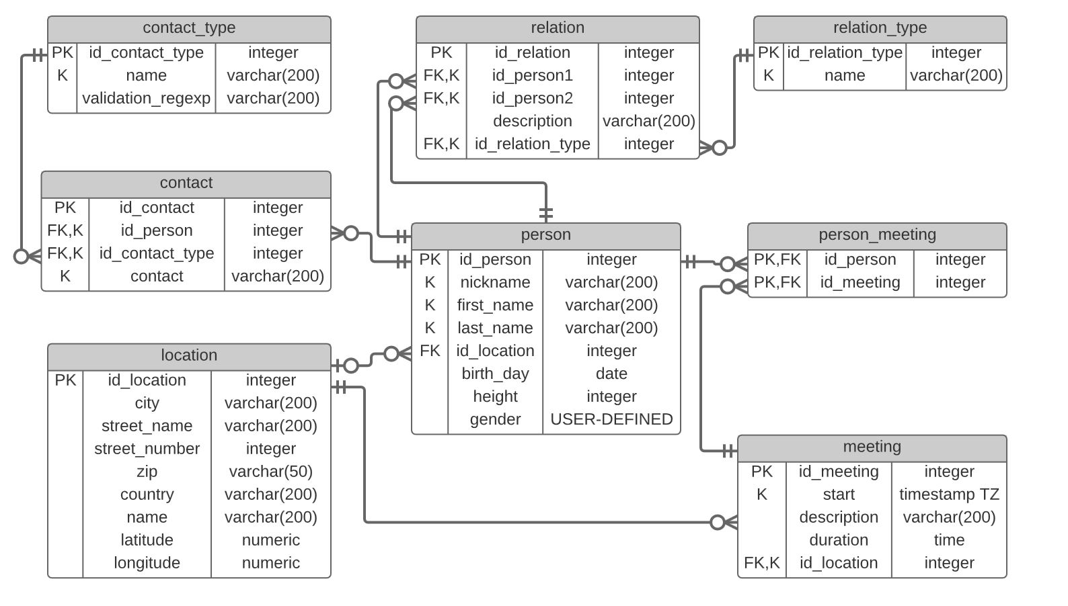
Database Schema – Logical (Cont..)

Slide 31
Database Instance
A database instance is a state of operational database with data at any given time. It contains a snapshot of the database. Database instances tend to change with time. A DBMS ensures that its every instance (state) is in a valid state, by diligently following all the validations, constraints, and conditions that the database designers have imposed.
It is the actual content of the database at a particular point in time

Slide 32
Data Independence
If a database system is not multi-layered, then it becomes difficult to make any changes in the database system. Database systems are designed in multi-layers.
A database system normally contains a lot of data in addition to users’ data. For example, it stores data about data, known as metadata, to locate and retrieve data easily. It is rather difficult to modify or update a set of metadata once it is stored in the database. But as a DBMS expands, it needs to change over time to satisfy the requirements of the users. If the entire data is dependent, it would become a tedious and highly complex job.

Slide 33
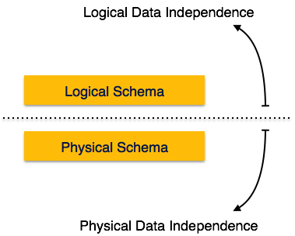
Data Independence (Cont..)
Metadata itself follows a layered architecture, so that when we change data at one layer, it does not affect the data at another level. This data is independent but mapped to each other.

Slide 34
Logical Data Independence
Logical data is data about database, that is, it stores information about how data is managed inside. For example, a table (relation) stored in the database and all its constraints, applied on that relation.
Logical data independence is a kind of mechanism, which liberalizes itself from actual data stored on the disk. If we do some changes on table format, it should not change the data residing on the disk.

Slide 35
Physical Data Independence
All the schemas are logical, and the actual data is stored in bit format on the disk. Physical data independence is the power to change the physical data without impacting or changing the logical schema.
For example, in case we want to change or upgrade the storage system itself − suppose we want to replace hard-disks with SSD − it should not have any impact on the logical data or schemas.
Applications depend on the logical schema
In general, the interfaces between the various levels and components should be well defined so that changes in some parts do not seriously influence others.

Slide 36
Database Architecture
Centralized databases
One to a few cores, shared memory
Client-server,
One server machine executes work on behalf of multiple client machines.
Parallel databases
Many core shared memory
Shared disk
Shared nothing
Distributed databases
Geographical distribution
Schema/data heterogeneity

Slide 37
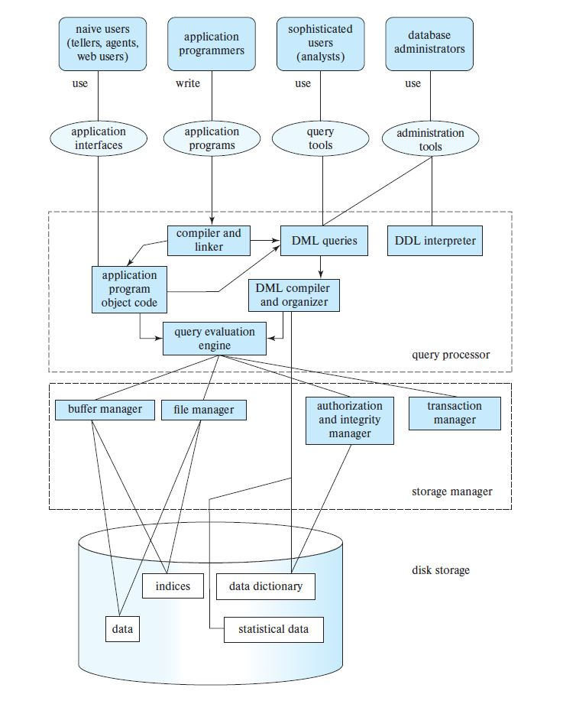
Database Architecture (Centralized/Shared-Memory)
Notes:
Naive Users
They are un-sophisticated users, which has no knowledge of the database.
They are the end users of the database who work through the menu-driven applications.
Naïve Users are just to work on developed applications and get the desired result.
For Example: Airplane ticket booking, Bank staff esp. on teller.
Sophisticated Users
Sophisticated users can be engineers, scientists, business anlaysts who are familiar with the database.
These Users interact with the database but they do not write programs.
# Database Engine
A database system is partitioned into modules that deal with each of the responsibilities of the overall system.
The functional components of a database system can be divided into
The storage manager,
The query processor component,
The transaction management component.
# Query processor
The query processor components include:
DDL (Data definition Language) interpreter -- interprets DDL statements and records the definitions in the data dictionary.
DML (Data Manipulation Language) compiler -- translates DML statements in a query language into an evaluation plan consisting of low-level instructions that the query evaluation engine understands.
The DML compiler performs query optimization; that is, it picks the lowest cost evaluation plan from among the various alternatives.
Query evaluation engine -- executes low-level instructions generated by the DML compiler.
# Query Processing
1. Parsing and translation
2. Optimization
3. Evaluation
# Storage Manager
A program module that provides the interface between the low-level data stored in the database and the application programs and queries submitted to the system.
The storage manager is responsible to the following tasks:
Interaction with the OS file manager
Efficient storing, retrieving and updating of data
The storage manager components include:
Authorization - It ensures role-based access control, i.e,. checks whether the particular person is privileged to perform the requested operation or not.
and integrity manager - It checks the integrity constraints when the database is modified.
Transaction manager - It controls concurrent access by performing the operations in a scheduled way that it receives the transaction. Thus, it ensures that the database remains in the consistent state before and after the execution of a transaction.
File manager - It manages the file space and the data structure used to represent information in the database.
Buffer manager - It is responsible for cache memory and the transfer of data between the secondary storage and main memory.
The storage manager implements several data structures as part of the physical system implementation:
Data files -- store the data of database
Data dictionary -- stores metadata about the structure of the database, in particular the schema of the database.
Indices -- can provide fast access to data items. A database index provides pointers to those data items that hold a particular value.
# Transaction Management
A transaction is a collection of operations that performs a single logical function in a database application
Transaction-management component ensures that the database remains in a consistent (correct) state despite system failures (e.g., power failures and operating system crashes) and transaction failures.
Concurrency-control manager controls the interaction among the concurrent transactions, to ensure the consistency of the database.

Slide 38
Naive Users
They are un-sophisticated users, which has no knowledge of the database.
They are the end users of the database who work through the menu-driven applications.
Naive Users are just to work on developed applications and get the desired result.
For Example: Airplane ticket booking, Bank staff esp. on teller.
Sophisticated Users
Sophisticated users can be engineers, scientists, business analysts who are familiar with the database.
These Users interact with the database but they do not write programs.

Slide 39
# Database Engine
A database system is partitioned into modules that deal with each of the responsibilities of the overall system.
The functional components of a database system can be divided into
The storage manager,
The query processor component,
The transaction management component.

Slide 40
# Query processor
The query processor components include:
DDL (Data definition Language) interpreter -- interprets DDL statements and records the definitions in the data dictionary.
DML (Data Manipulation Language) compiler -- translates DML statements in a query language into an evaluation plan consisting of low-level instructions that the query evaluation engine understands.
The DML compiler performs query optimization; that is, it picks the lowest cost evaluation plan from among the various alternatives.
Query evaluation engine -- executes low-level instructions generated by the DML compiler.

Slide 41
# Query Processing
1. Parsing and translation
2. Optimization
3. Evaluation

Slide 42
# Storage Manager
A program module that provides the interface between the low-level data stored in the database and the application programs and queries submitted to the system.
The storage manager is responsible to the following tasks:
Interaction with the OS file manager
Efficient storing, retrieving and updating of data
The storage manager components include:
Authorization - It ensures role-based access control, i.e,. checks whether the particular person is privileged to perform the requested operation or not.
and integrity manager - It checks the integrity constraints when the database is modified.
Transaction manager - It controls concurrent access by performing the operations in a scheduled way that it receives the transaction. Thus, it ensures that the database remains in the consistent state before and after the execution of a transaction.

Slide 43
File manager - It manages the file space and the data structure used to represent information in the database.
Buffer manager - It is responsible for cache memory and the transfer of data between the secondary storage and main memory.
The storage manager implements several data structures as part of the physical system implementation:
Data files -- store the data of database
Data dictionary -- stores metadata about the structure of the database, in particular the schema of the database.
Indices -- can provide fast access to data items. A database index provides pointers to those data items that hold a particular value.
# Transaction Management
A transaction is a collection of operations that performs a single logical function in a database application

Slide 44
Transaction-management component ensures that the database remains in a consistent (correct) state despite system failures (e.g., power failures and operating system crashes) and transaction failures.
Concurrency-control manager controls the interaction among the concurrent transactions, to ensure the consistency of the database.

Slide 45
Database Users
Naive Users
They are un-sophisticated users, which has no knowledge of the database.
They are the end users of the database who work through the menu-driven applications.
Naïve Users are just to work on developed applications and get the desired result.
For Example: Airplane ticket booking, Bank staff esp. on teller.
Sophisticated Users
Sophisticated users can be engineers, scientists, business anlaysts who are familiar with the database.
These Users interact with the database but they do not write programs.

Slide 46
Database Administrator
A person who has central control over the system is called a database administrator (DBA). Functions of a DBA include:
Schema definition
Storage structure and access-method definition
Schema and physical-organization modification
Granting of authorization for data access
Routine maintenance
Periodically backing up the database
Ensuring that enough free disk space is available for normal operations, and upgrading disk space as required
Monitoring jobs running on the database

Slide 47
Database Engine
A database system is partitioned into modules that deal with each of the responsibilities of the overall system.
The functional components of a database system can be divided into
The query processor component
The storage manager,
The transaction management component.

Slide 48
Query Processor
The query processor components include:
DDL interpreter - interprets DDL statements and records the definitions in the data dictionary.
DML compiler - translates DML statements in a query language into an evaluation plan consisting of low-level instructions that the query evaluation engine understands.
The DML compiler performs query optimization; that is, it picks the lowest cost evaluation plan from among the various alternatives.
Query evaluation engine - executes low-level instructions generated by the DML compiler.

Slide 49
Query Processing
1. Parsing and translation
2. Optimization
3. Evaluation
Notes:
A parser is a software component that takes input data (frequently text) and builds a data structure.
Optimization - the action of making the best or most effective use of a situation or resource.
Evaluation - the making of a judgement about the amount, number, or value of something; assessment.

Slide 50
Storage Manager
A program module that provides the interface between the low-level data stored in the database and the application programs and queries submitted to the system.
The storage manager is responsible to the following tasks:
Interaction with the OS file manager
Efficient storing, retrieving and updating of data
The storage manager components include:
Authorization and integrity manager
Transaction manager
File manager
Buffer manager
Notes:
# Buffer Manager
The subsystem responsible for the allocation of buffer space is called the buffer manager.
The buffer manager handles all requests for blocks of the database.
If the block is already in main memory, the address in main memory is given to the requester.
If not, the buffer manager must read the block in from disk (possibly displacing some other block if the buffer is full) and then pass the address in main memory to the requester.

Slide 51
Storage Manager (Cont..)
The storage manager implements several data structures as part of the physical system implementation in disk storage:
Data files - store the data of database.
Data dictionary - stores metadata about the structure of the database, in particular the schema of the database.
Indices - can provide fast access to data items. A database index provides pointers to those data items that hold a particular value.

Slide 52
Transaction Management
A transaction is a collection of operations that performs a single logical function in a database application
Transaction-management component ensures that the database remains in a consistent (correct) state despite system failures (e.g., power failures and operating system crashes) and transaction failures.
Concurrency-control manager controls the interaction among the concurrent transactions, to ensure the consistency of the database.

Slide 53
Database Applications
Database applications are usually partitioned into two or three parts
Two-tier architecture - The application resides at the client machine, where it invokes database system functionality at the server machine
Three-tier architecture - The client machine acts as a front end and does not contain any direct database calls.
The client end communicates with an application server, usually through a forms interface.
The application server in turn communicates with a database system to access data.

Slide 54
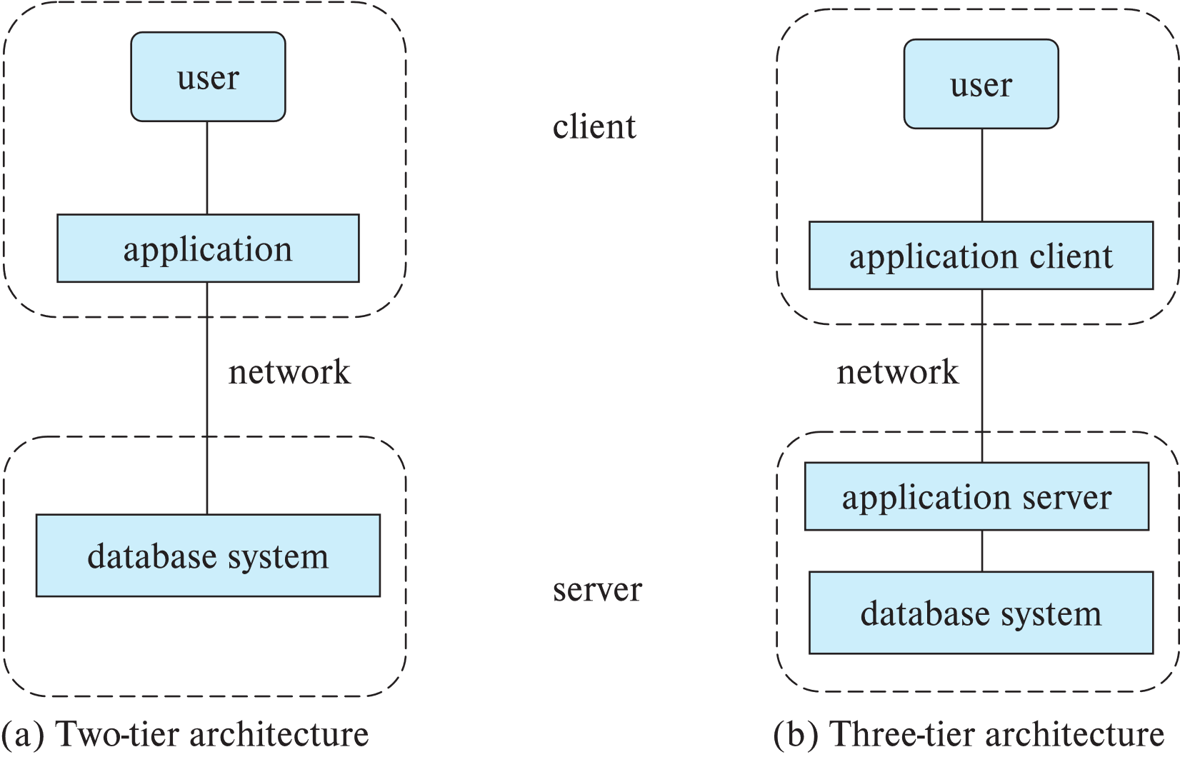
Two-tier and three-tier architecture

Slide 55
Why Database Access from Application Program
SQL does not support actions such as input from users, output to displays, or communication over the network.
Such computations and actions must be written in a host language, such as C/C++, Java or Python, with embedded SQL queries that access the data in the database.
Application programs - are programs that are used to interact with the database in this fashion.

Slide 56
Database Languages:
Structured Query Language(SQL) – It is the database language by the use of which we can perform certain operations on the existing database and also we can use this language to create a database. SQL uses certain commands like Create, Drop, Insert etc. to carry out the required tasks.
Query By Example (QBE) - It is a query language used in relational databases that allows users to search for information in tables and fields by providing a simple user interface where the user will be able to input an example of the data that he or she wants to access. The principle of QBE is that it is merely an abstraction between the user and the real query that the database system will receive. In the background, the user's query is transformed into a database manipulation language form such as SQL, and it is this SQL statement that will be executed in the background.

Slide 57
SQL Categories
DDL – Data Definition Language
DML – Data Manipulation Language
DQI – Data Query Language
DCL – Data Control Language
TCL – Transaction Control Language

Slide 58
Data Definition Language (DDL)
DDL consists of the SQL commands that can be used to define the database schema. It simply deals with descriptions of the database schema and is used to create and modify the structure of database objects in the database.
Example:
CREATE - used to create the database or its objects (like table, index, function, views, store procedure and triggers).
DROP - used to delete objects from the database.
ALTER - used to alter the structure of the database.
TRUNCATE - used to remove all records from a table, including all spaces allocated for the records are removed.
COMMENT - used to add comments to the data dictionary.
RENAME - used to rename an object existing in the database.

Slide 59
Data Manipulation Language (DML)
The SQL commands that deals with the manipulation of data present in the database belong to DML or Data Manipulation.
Examples of DML:
INSERT – used to insert data into a table.
UPDATE – used to update existing data within a table.
DELETE – used to delete records from a database table.

Slide 60
Data Query Language (DQL)
It is used for performing queries on the data within schema objects. The purpose of DQL Command is to get some schema relation based on the query passed to it.
Example of DQL:
SELECT – used to retrieve data from the a database.

Slide 61
Data Control Language (DCL)
It deals with the rights, permissions and other controls of the database system.
Examples of DCL commands:
GRANT - It gives user’s access privileges to database.
REVOKE - It withdraws user’s access privileges given by using the GRANT command.

Slide 62
Transaction Control Language (TCL)
TCL commands deals with the transaction within the database.
Examples of TCL commands:
COMMIT – commits a Transaction.
ROLLBACK – rollbacks a transaction in case of any error occurs.
SAVEPOINT – sets a savepoint within a transaction.
SET TRANSACTION – specify characteristics for the transaction.

Slide 63
E-R Diagram
An entity-relationship (E-R diagram) is an graphical representation of data for an organization at conceptual level or logical level.
E-R diagrams are frequently used by database designers to build data models in the process of database development.
A well-drawn E-R diagram can be transformed into relational database tables easily: Entities will be mapped into tables and attributes will be mapped into fields.
There are so many software tools available offline and online to create E-R diagram. Eg: Microsoft Visio, Edraw Max, SmartDraw, Lucidchart, app.diagrams.net

Slide 64
Reasons for using ER Diagram
Provide a preview of how all your tables should connect, what fields are going to be on each table
Helps to describe entities, attributes, relationships
ER diagrams are translatable into relational tables which allows you to build databases quickly
ER diagrams can be used by database designers as a blueprint for implementing data in specific software applications
The database designer gains a better understanding of the information to be contained in the database with the help of ERP diagram

Slide 65
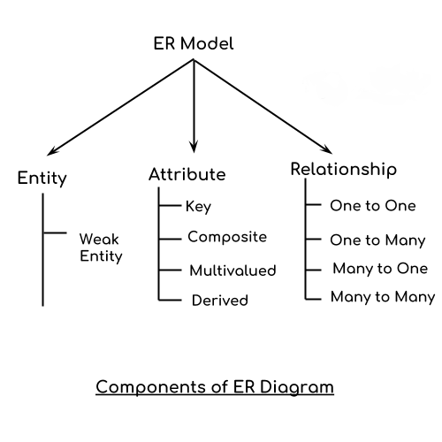
Components of the ER Diagram
The basic constructs of ER Diagram are entities, attributes and relationship.

Slide 66
Geometric Shapes and their meaning in E-R Diagram
Rectangle: Represents Entity sets
Double Rectangles: Weak Entity Sets
Ellipses: Attributes
Double Ellipses: Multivalued Attributes
Dashed Ellipses: Derived Attributes
Ellipses with underlined Attributes: Key attributes for any Entity
Diamonds or Rhombus: Relationship Set
Double Diamonds or Double Rhombus: Weak Relationship set
Lines: They link attributes to Entity Sets and Entity sets to Relationship Set
Double Lines: Total participation of an entity in a relationship set

Slide 67
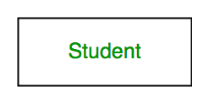
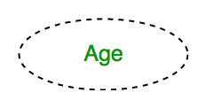
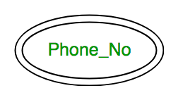
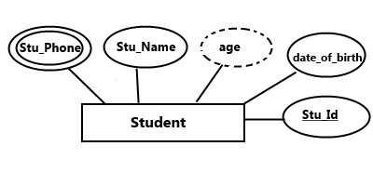
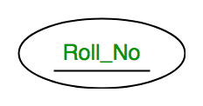
Check Yourself!!
Identify the symbols

Slide 68
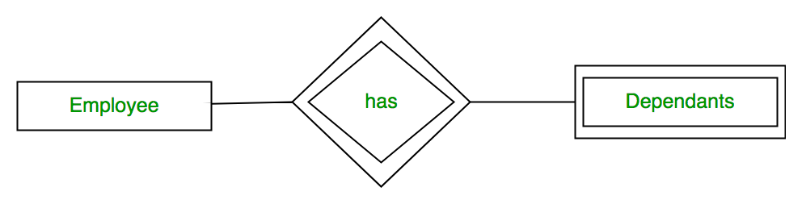
Check yourself!!
What the given ER-Diagram describes? Which type of Entity is Dependents? Which type of relation is shown below?

Slide 69
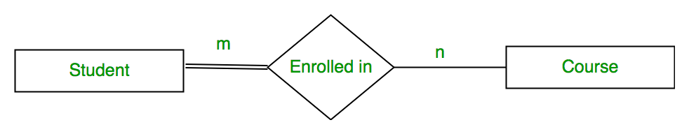
Check yourself!!
What does double line represent in ER-Diagram?

Slide 70
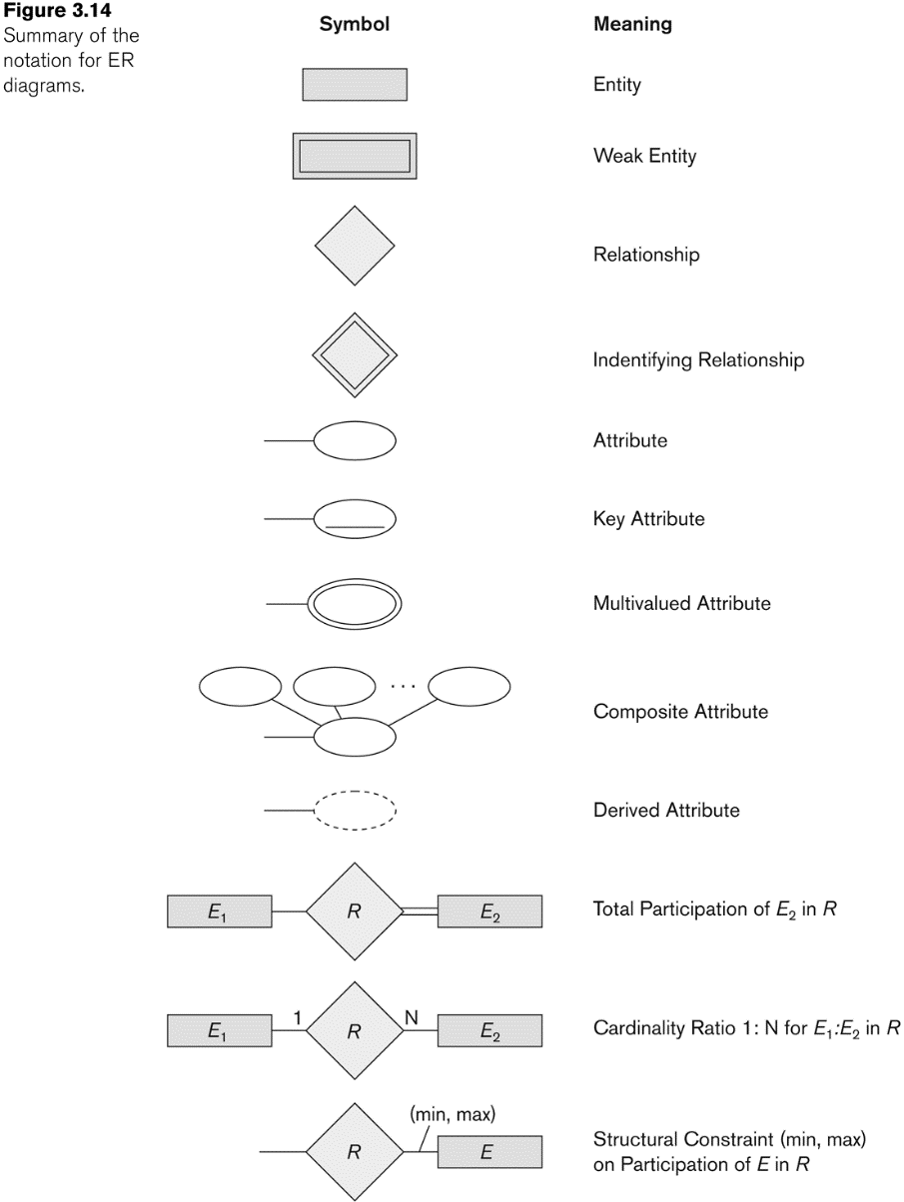
ER-Diagram: Symbol & its meaning

Slide 71
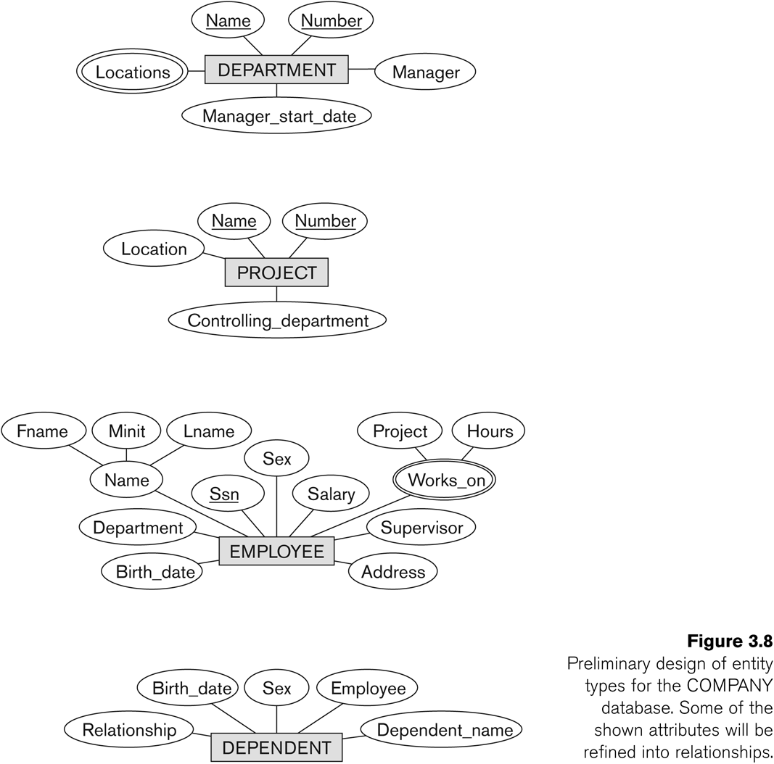
Describe it yourself!!
Describe Entity & attributes

Slide 72
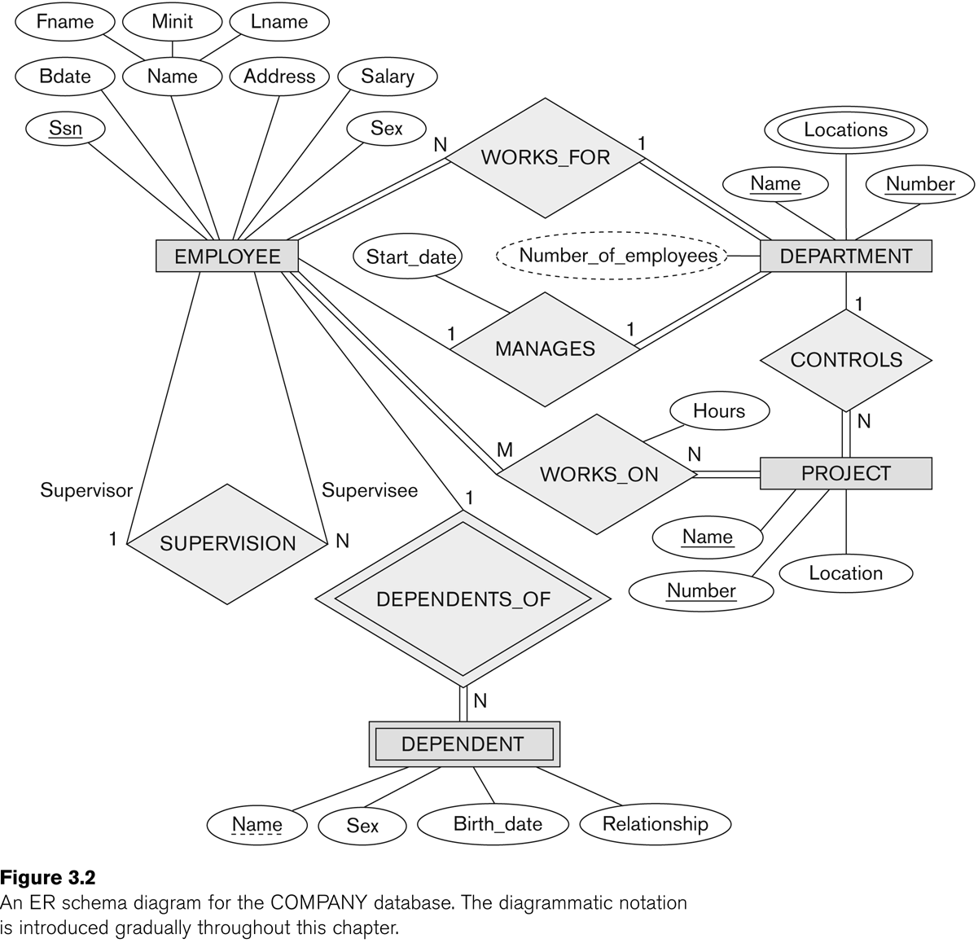
ER Schema Diagram for the COMPANY Database

Slide 73
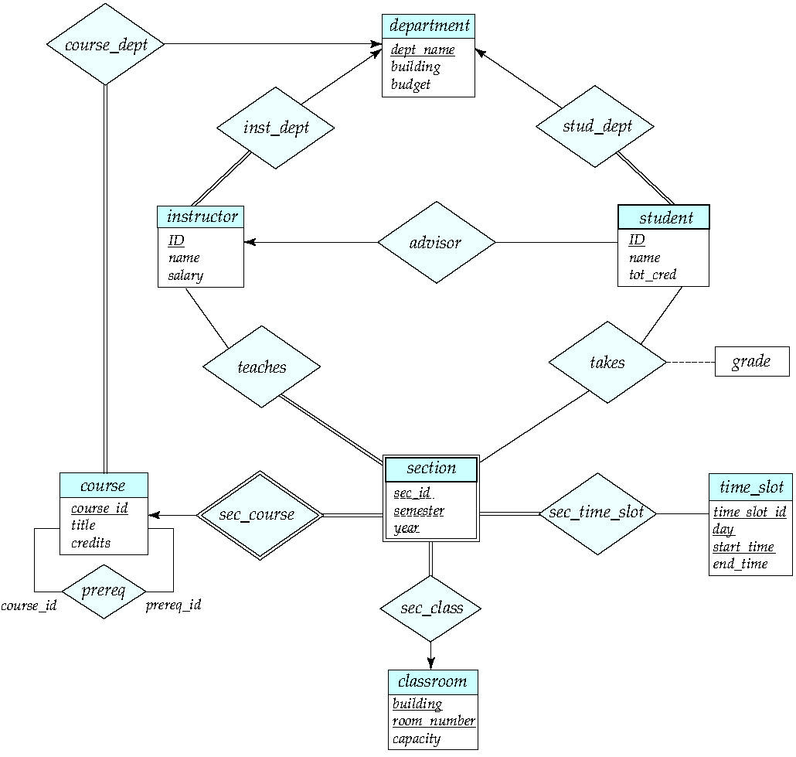
E-R Diagram for a University Enterprise

Slide 74
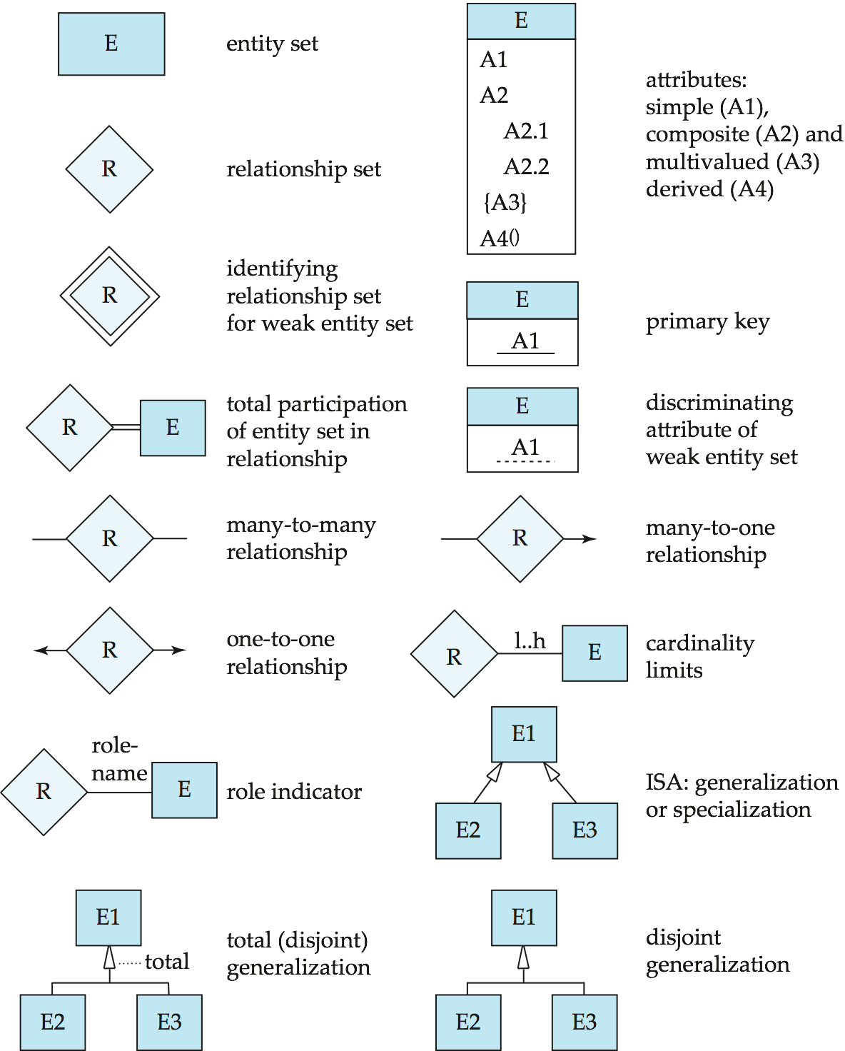
Summary of Symbols Used in E-R Notation

Slide 75
Summary of Symbols Used in E-R Notation (Cont..)

Slide 76
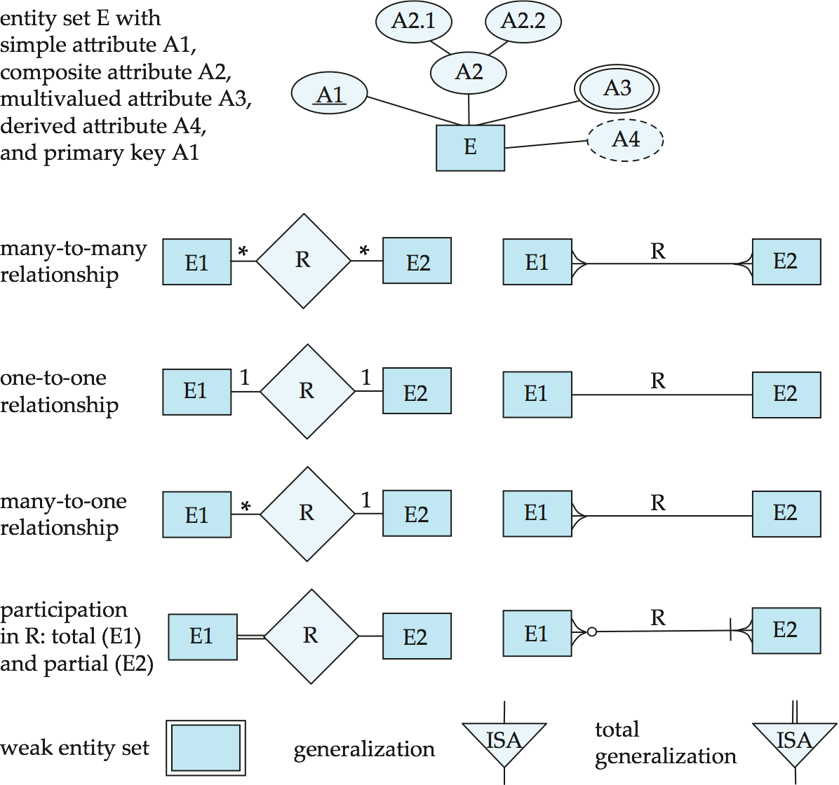
Alternative ER Notations
Chen, IDE1FX, …

Slide 77
Alternative ER-Notations
Chen IDE1FX (Crows feet notation)

Slide 78
Entity
An entity is a real-world thing either living or non-living that is easily recognizable and non-recognizable. It is anything in the enterprise that is to be represented in our database. It may be a physical thing or simply a fact about the enterprise or an event that happens in the real world.
An entity can be place, person, object, event or a concept, which stores data in the database. The characteristics of entities are must have an attribute, and a unique key. Every entity is made up of some 'attributes' which represent that entity.

Slide 79
Example of entities:
Person: Employee, Student, Patient
Place: Store, Building
Object: Machine, product, and Car
Event: Sale, Registration, Renewal
Concept: Account, Course

Slide 80
Weak Entity Sets
Consider a section entity, which is uniquely identified by a course_id, semester, year, and sec_id.
Clearly, section entities are related to course entities. Suppose we create a relationship set sec_course between entity sets section and course.
Note that the information in sec_course is redundant, since section already has an attribute course_id, which identifies the course with which the section is related.
One option to deal with this redundancy is to get rid of the relationship sec_course; however, by doing so the relationship between section and course becomes implicit in an attribute, which is not desirable.

Slide 81
Weak Entity Sets (Cont.)
An alternative way to deal with this redundancy is to not store the attribute course_id in the section entity and to only store the remaining attributes section_id, year, and semester. However, the entity set section then does not have enough attributes to identify a particular section entity uniquely; although each section entity is distinct, sections for different courses may share the same section_id, year, and semester.
To deal with this problem, we treat the relationship sec_course as a special relationship that provides extra information, in this case, the course_id, required to identify section entities uniquely.
The notion of weak entity set formalizes the above intuition. A weak entity set is one whose existence is dependent on another entity, called its identifying entity; instead of associating a primary key with a weak entity, we use the identifying entity, along with extra attributes called discriminator to uniquely identify a weak entity. An entity set that is not a weak entity set is termed a strong entity set.

Slide 82
Weak Entity Sets (Cont.)
Every weak entity must be associated with an identifying entity; that is, the weak entity set is said to be existence dependent on the identifying entity set. The identifying entity set is said to own the weak entity set that it identifies. The relationship associating the weak entity set with the identifying entity set is called the identifying relationship.
Note that the relational schema we eventually create from the entity set section does have the attribute course_id, for reasons that will become clear later, even though we have dropped the attribute course_id from the entity set section.

Slide 83
Associative Entity & Relationship
An associative entity is the table that associates two other tables in a many to many relationship.
An associative relationship attribute is an attribute of the associative entity that exists because of the many to many relationship.
Study
Students
Books
Transaction

Slide 84
Relationship Sets
A relationship is an association among several entities
Example: 44553 (Peltier) advisor 22222 (Einstein) student entity relationship set instructor entity
An attribute can also be associated with a relationship set.
For instance, the advisor relationship set between entity sets instructor and student may have the attribute date which tracks when the student started being associated with the advisor

Slide 85
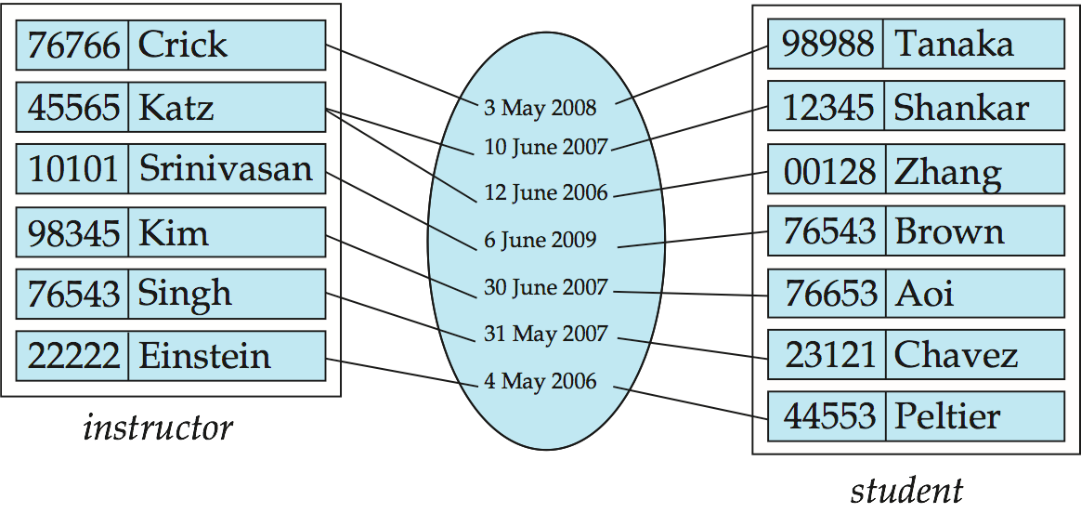
Relationship Sets (Cont..)

Slide 86
Degree of a Relationship Set
binary relationship
involve two entity sets (or degree two).
most relationship sets in a database system are binary.
Relationships between more than two entity sets are rare. Most relationships are binary. (More on this later.)
Example: students work on research projects under the guidance of an instructor.
relationship proj_guide is a ternary relationship between instructor, student, and project

Slide 87
Mapping Cardinality Constraints
Express the number of entities to which another entity can be associated via a relationship set.
Most useful in describing binary relationship sets.
For a binary relationship set the mapping cardinality must be one of the following types:
One to one
One to many
Many to one
Many to many

Slide 88
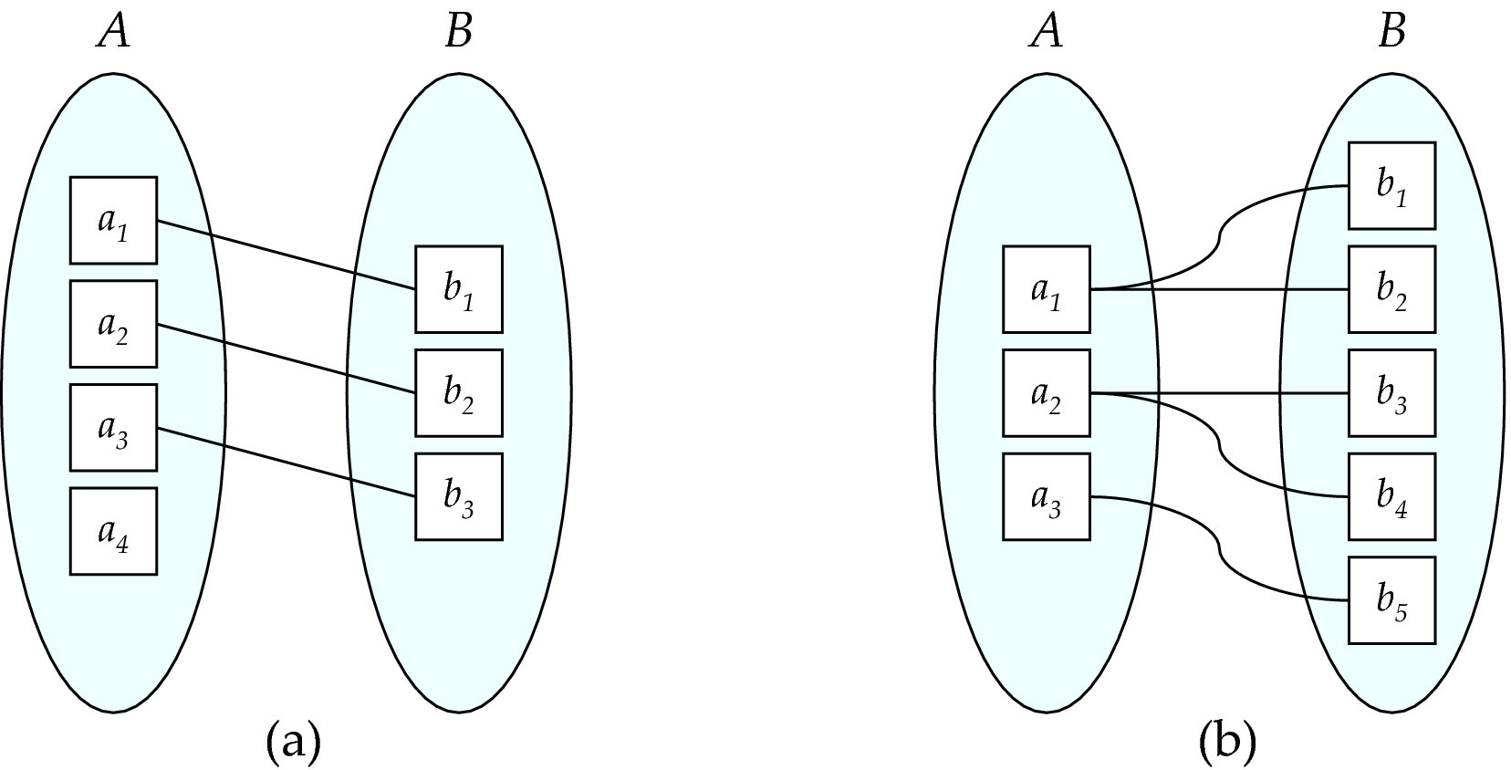
Mapping Cardinalities
One to one
One to many
Note: Some elements in A and B may not be mapped to any elements in the other set

Slide 89
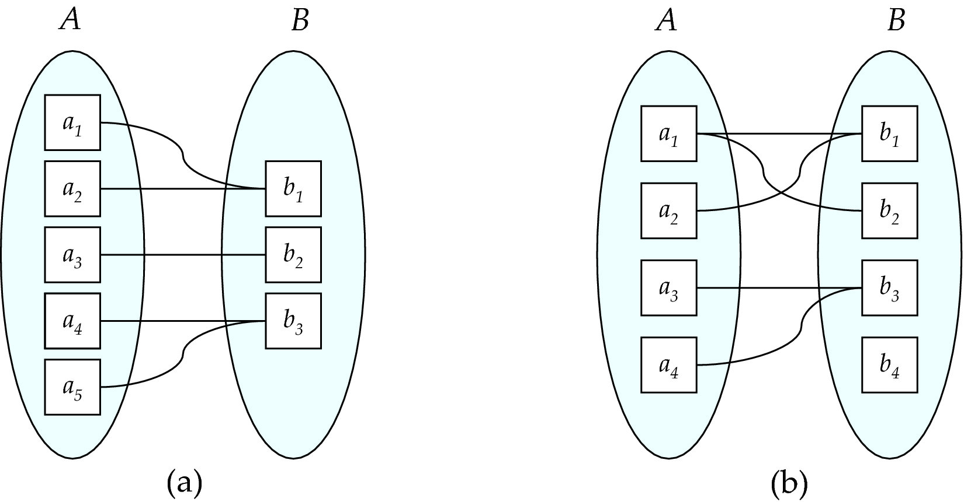
Mapping Cardinalities
Many to one
many to many
Note: Some elements in A and B may not be mapped to any elements in the other set

Slide 90
Complex Attributes
Attribute types:
Simple and composite attributes.
Single-valued and multivalued attributes
Example: multivalued attribute: phone_numbers
Derived attributes
Can be computed from other attributes
Example: age, given date_of_birth
Domain – the set of permitted values for each attribute

Slide 91
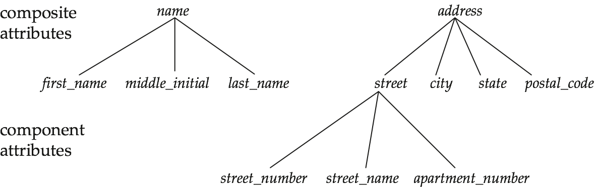
Composite Attributes

Slide 92
Redundant Attributes
Suppose we have entity sets:
instructor, with attributes: ID, name, dept_name, salary
department, with attributes: dept_name, building, budget
We model the fact that each instructor has an associated department using a relationship set inst_dept
The attribute dept_name appears in both entity sets. Since it is the primary key for the entity set department, it replicates information present in the relationship and is therefore redundant in the entity set instructor and needs to be removed.
BUT: when converting back to tables, in some cases the attribute gets reintroduced.

Slide 93
Specialization
Top-down design process; we designate sub-groupings within an entity set that are distinctive from other entities in the set.
These sub-groupings become lower-level entity sets that have attributes or participate in relationships that do not apply to the higher-level entity set.
Depicted by a triangle component labeled ISA (e.g., instructor “is a” person).
Attribute inheritance – a lower-level entity set inherits all the attributes and relationship participation of the higher-level entity set to which it is linked.

Slide 94
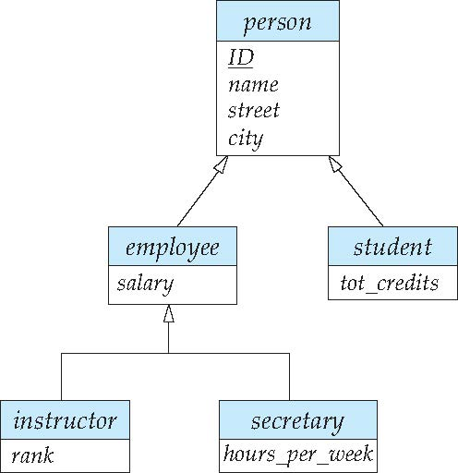
Specialization Example
Overlapping – employee and student
Disjoint – instructor and secretary
Total and partial
Person
ISA
Employee
Student
ISA
Instructor
Secretary

Slide 95
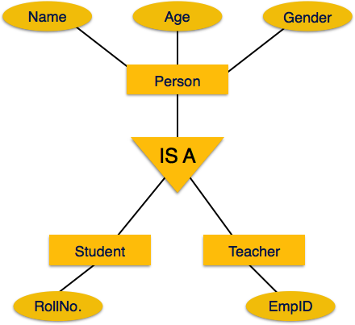

Slide 96
Representing Specialization via Schemas
Method 1:
Form a schema for the higher-level entity
Form a schema for each lower-level entity set, include primary key of higher-level entity set and local attributes
Drawback: getting information about, an employee requires accessing two relations, the one corresponding to the low-level schema and the one corresponding to the high-level schema
schema attributes
person ID, name, street, city
student ID, tot_cred
Employe e ID, salary

Slide 97
Representing Specialization as Schemas (Cont.)
Method 2:
Form a schema for each entity set with all local and inherited attributes
Drawback: name, street and city may be stored redundantly for people who are both students and employees
schema attributes
person ID, name, street, city
student ID, name, street, city, tot_cred
Employee ID, name, street, city, salary

Slide 98
Generalization
A bottom-up design process – combine a number of entity sets that share the same features into a higher-level entity set.
Specialization and generalization are simple inversions of each other; they are represented in an E-R diagram in the same way.
The terms specialization and generalization are used interchangeably.

Slide 99
Design Constraints on a Specialization/Generalization
Completeness constraint -- specifies whether or not an entity in the higher-level entity set must belong to at least one of the lower-level entity sets within a generalization.
total: an entity must belong to one of the lower-level entity sets
partial: an entity need not belong to one of the lower-level entity sets
Partial generalization is the default. We can specify total generalization in an ER diagram by adding the keyword total in the diagram and drawing a dashed line from the keyword to the corresponding hollow arrow-head to which it applies (for a total generalization), or to the set of hollow arrow-heads to which it applies (for an overlapping generalization).
The student generalization is total: All student entities must be either graduate or undergraduate. Because the higher-level entity set arrived at through generalization is generally composed of only those entities in the lower-level entity sets, the completeness constraint for a generalized higher-level entity set is usually total

Slide 100
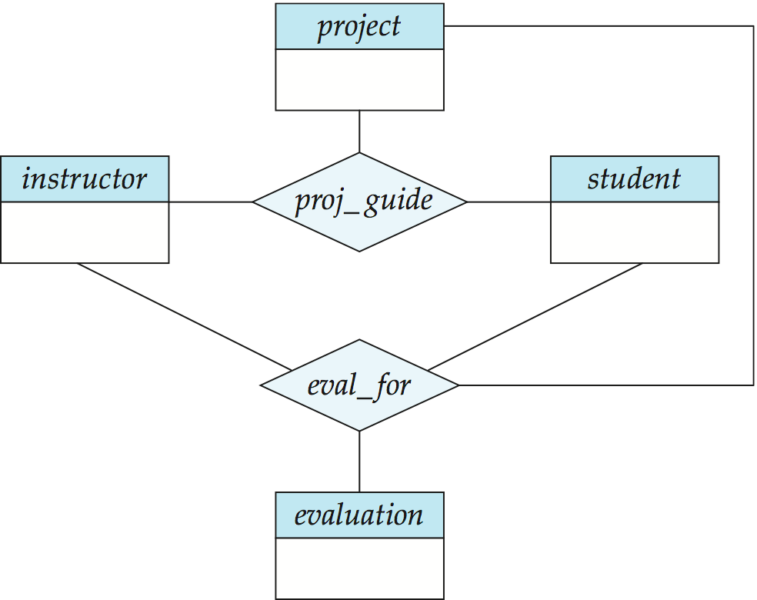
Aggregation
Consider the ternary relationship proj_guide, which we saw earlier
Suppose we want to record evaluations of a student by a guide on a project

Slide 101
Aggregation (Cont.)
Relationship sets eval_for and proj_guide represent overlapping information
Every eval_for relationship corresponds to a proj_guide relationship
However, some proj_guide relationships may not correspond to any eval_for relationships
So we can’t discard the proj_guide relationship
Eliminate this redundancy via aggregation
Treat relationship as an abstract entity
Allows relationships between relationships
Abstraction of relationship into new entity

Slide 102
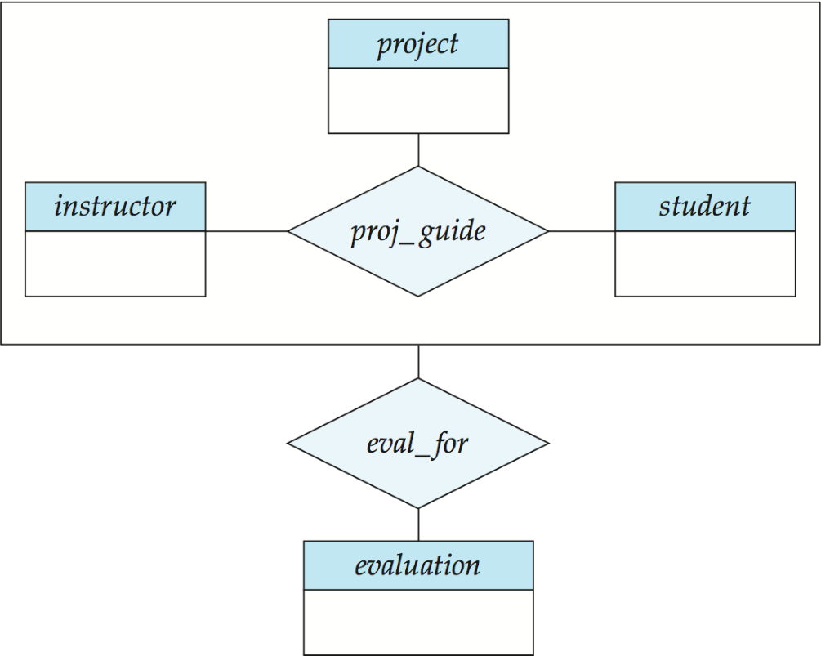
Aggregation (Cont.)
Eliminate this redundancy via aggregation without introducing redundancy, the following diagram represents:
A student is guided by a particular instructor on a particular project
A student, instructor, project combination may have an associated evaluation

Slide 103
Representing Aggregation via Schemas
To represent aggregation, create a schema containing
Primary key of the aggregated relationship,
The primary key of the associated entity set
Any descriptive attributes
In our example:
The schema eval_for is:
eval_for (s_ID, project_id, i_ID, evaluation_id)
The schema proj_guide is redundant.

Slide 112
Q&A

Slide 113
Thank You !!!

